Slide 1
Introduction to HTTP Servlets
Presented by : Dadaram Jadhav

Slide 2
Document History
Version No. | Authored/ Modified by | Remarks/ Change History | Date <dd- mon-yy >

Slide 3
Course Structure
Target audience
Level
Pre-requisites
Training methods
Evaluation

Slide 4
Agenda
Basics of HTTP
What is Servlet
Servlet API
Servlets Lifecycle
Servlet 3.0 Annotation

Slide 5
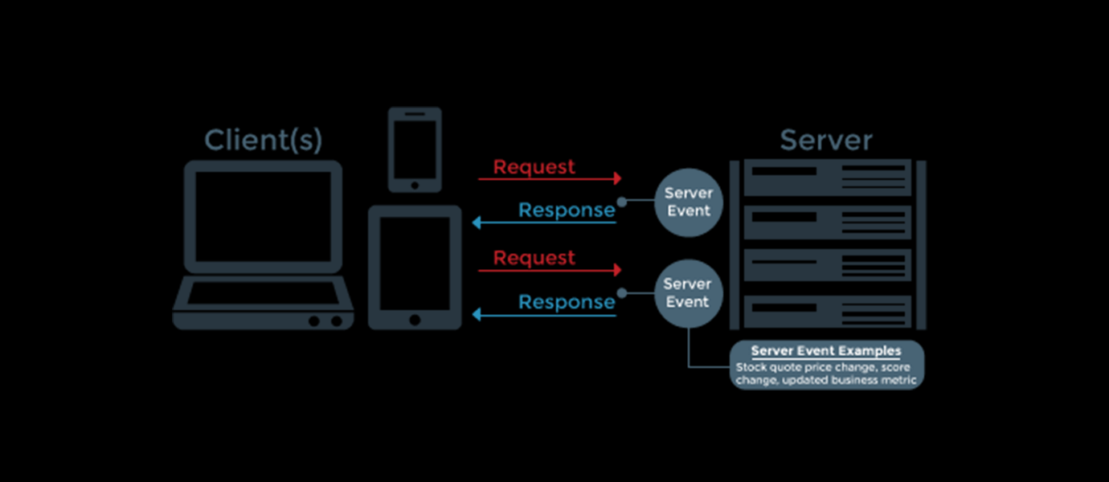
What is HTTP?

Slide 6
What is HTTP?
The term HTTP was coined by Ted Nelson.
HTTP is the underlying protocol used by the World Wide Web.
HTTP is a Stateless Protocol.
The standard port for HTTP connections is port 80.
It has its own methods and status codes.

Slide 7
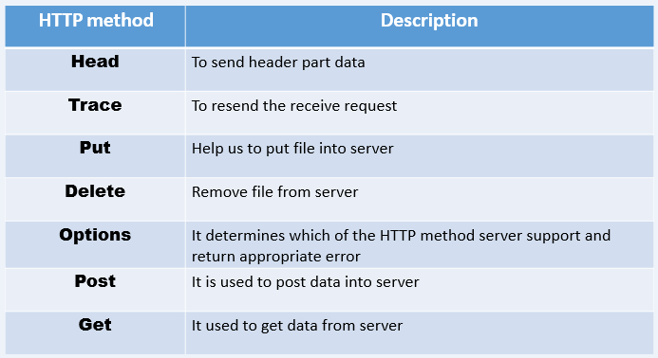
Basic Slide - Headline

Slide 8
HTTP status Code
1xx - 2xx | 3xx - 4xx | 5xx
100 (Continue) 101 (Switch protocols) 102 (Processing) 200 (Success) 201 (Fulfilled) 202 (Accepted) 204 (No content) 205 (Reset content) 206 (Partial content) 207 (Multi-Status) | 301 (Moved permanently) 302 (Moved temporarily) 304 (Loaded Cached copy) 307 (Internal redirect) 400 (Bad request) 401 (Authorization required) 402 (Payment required) 403 (Forbidden) 404 (Not found) 405 (Method not allowed) 406 (Not acceptable) 407 (Proxy authentication required) 408 (Request timeout) 409 (Conflict) 410 (Gone) 411 (Length required) 412 (Precondition failed) 413 (Request entity too large) 414 (Request URI too large) 415 (Unsupported media type) 416 (Request range not satisfiable) 417 (Expectation failed) 422 (Unprocessable entity) 423 (Locked) 424 (Failed dependency) | 500 (Internal server error) 501 (Not Implemented) 502 (Bad gateway) 503 (Service unavailable) 504 (Gateway timeout) 505 (HTTP version not supported) 506 (Variant also negotiates) 507 (Insufficient storage) 510 (Not extended)

Slide 9
What is Servlet?
Servlet is a technology to create web application.
Servlet is an interface that must be implemented for creating any servlet.
Servlet is a class that extend the capabilities of the servers and respond to the incoming request.
It’s a web component deployed on the server to create dynamic web page.

Slide 10
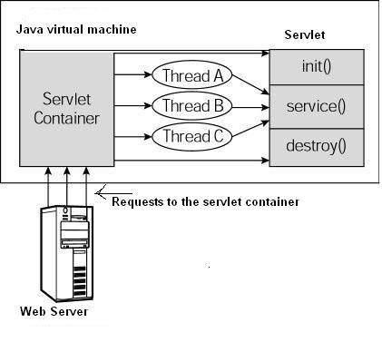
Architecture Diagram

Slide 11
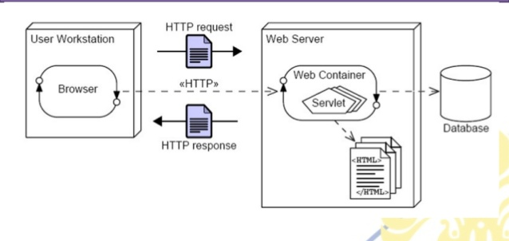
Web Container Architecture

Slide 12
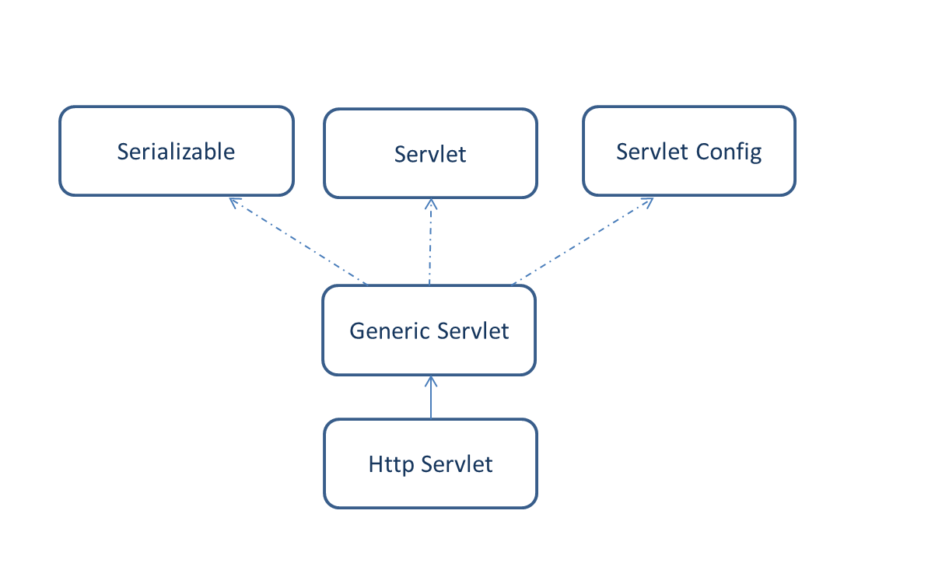
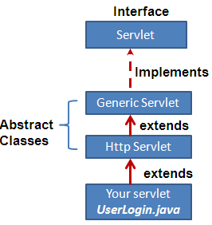
Servlet API

Slide 13
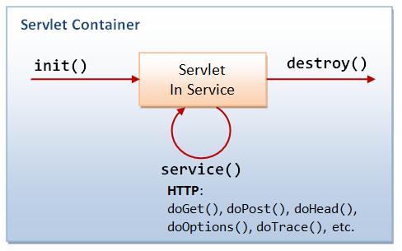
Servlet Lifecycle

Slide 14
Servlet 3.0 Annotation
The @WebServlet annotation is used to declare a servlet.
The annotated class must extend the javax.servlet.http.HttpServlet class.
Syntax of @WebServlet Annotation:
@WebServlet(attribute1=value1,attribute2=value2,….)
public class YourServlet extends javax.servlet.http.HttpServlet {
// servlet code...
}

Slide 15
Attributes of @WebServlet Annotation:
Name | Type | Required | Description
value or urlPatterns | String[] | Required | Specify one or more URL patterns of the servlet. Either of attribute can be used, but not both.
name | String | Optional | Name of the servlet
displayName | String | Optional | Display name of the servlet
description | String | Optional | Description of the servlet
asyncSupported | boolean | Optional | Specify whether the servlet supports asynchronous operation mode. Default is false.
initParams | WebInitParam[] | Optional | Specify one or more initialization parameters of the servlet. Each parameter is specified by @WebInitParam annotation type.
loadOnStartup | int | Optional | Specify load-on-startup order of the servlet.
smallIcon | String | Optional | Specify name of the small icon of the servlet.
largeIcon | String | Optional | Specify name of the large icon of the servlet.

Slide 16


Copyright © 2019 Cybage Software Pvt. Ltd. All Rights Reserved. Cybage Confidential.
www.cybage.com

Slide 17


Thank You!
11/4/2020
www.cybage.com
Copyright © 2019 Cybage Software Pvt. Ltd. All Rights Reserved. Cybage Confidential.

